Slide 1
A Perfectly Competitive Market
In a perfectly competitive market, each firm chooses how much of each input to buy and how much of its output to produce, but the firm cannot change the price it pays for its inputs and the price it charges for its output.
<<< Price Taker>>>

Slide 2
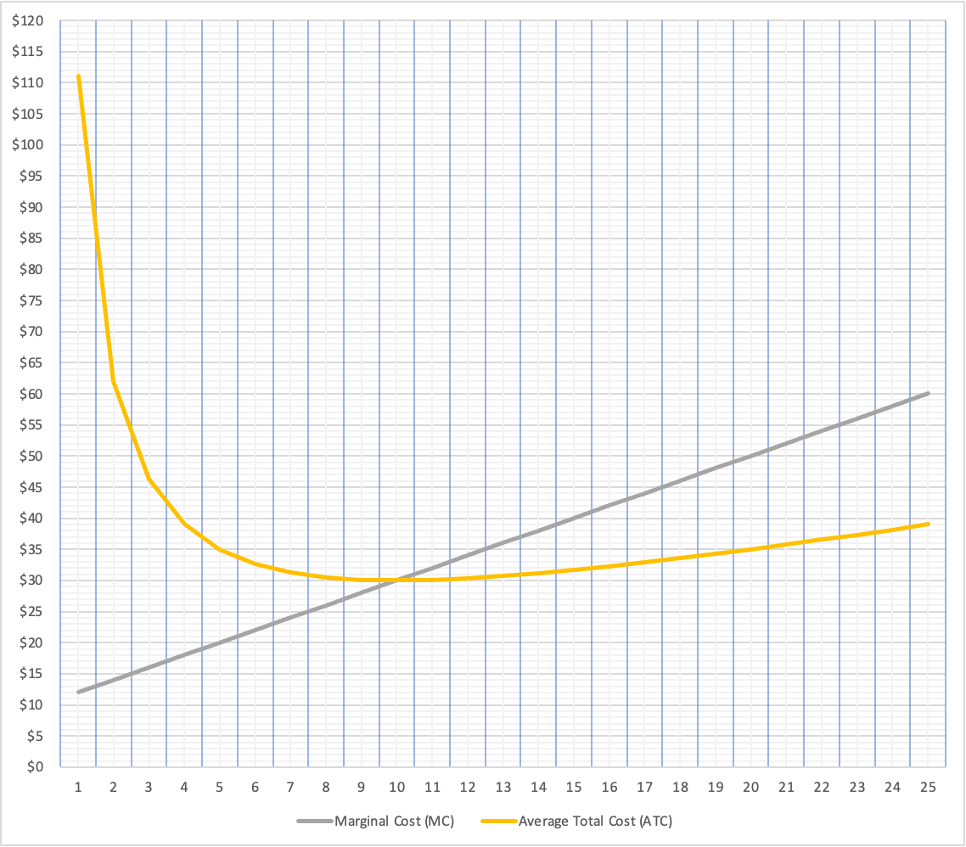
Review
Quantity (QQQ) | Total Cost (TC) | Marginal Cost (MC) | Average Total Cost (ATC)
1 | $111 | $12 | $111.00
2 | $124 | $14 | $62.00
3 | $139 | $16 | $46.33
4 | $156 | $18 | $39.00
5 | $175 | $20 | $35.00
6 | $196 | $22 | $32.67
7 | $219 | $24 | $31.29
8 | $244 | $26 | $30.50
9 | $271 | $28 | $30.11
10 | $300 | $30 | $30.00
11 | $331 | $32 | $30.09
12 | $364 | $34 | $30.33
13 | $399 | $36 | $30.69
14 | $436 | $38 | $31.14
15 | $475 | $40 | $31.67
16 | $516 | $42 | $32.25
17 | $559 | $44 | $32.88
18 | $604 | $46 | $33.56
19 | $651 | $48 | $34.26
20 | $700 | $50 | $35.00
21 | $751 | $52 | $35.76
22 | $804 | $54 | $36.55
23 | $859 | $56 | $37.35
24 | $916 | $58 | $38.17
25 | $975 | $60 | $39.00

Slide 3
A Perfectly Competitive Market
Perfectly competitive market:

Slide 4
A Perfectly Competitive Market
Perfectly competitive market:
1) Products are fairly homogeneous

Slide 5
A Perfectly Competitive Market
Perfectly competitive market:
1) Products are fairly homogeneous
2) Large number of small sellers and buyers

Slide 6
A Perfectly Competitive Market
Perfectly competitive market:
1) Products are fairly homogeneous
2) Large number of small sellers and buyers
3) Buyers and sellers have enough information

Slide 7
A Perfectly Competitive Market
Perfectly competitive market:
1) Products are fairly homogeneous
2) Large number of small sellers and buyers
3) Buyers and sellers have enough information
4) Free entry and free exit

Slide 8
Who likes a perfectly competitive market?

Slide 9
A Perfectly Competitive Market
BUSINESS SCHOOL TERM – Commoditization

Slide 10
A Perfectly Competitive Market
1) Products are fairly homogeneous
2) Large number of small sellers and buyers
3) Buyers and sellers have enough information
4) Free entry and free exit
In groups: Can you think of a perfectly competitive market?

Slide 11
https://www.youtube.com/watch?v=EtqVmE2U4Xo

Slide 12
Why firms hate perfect competition

Slide 13
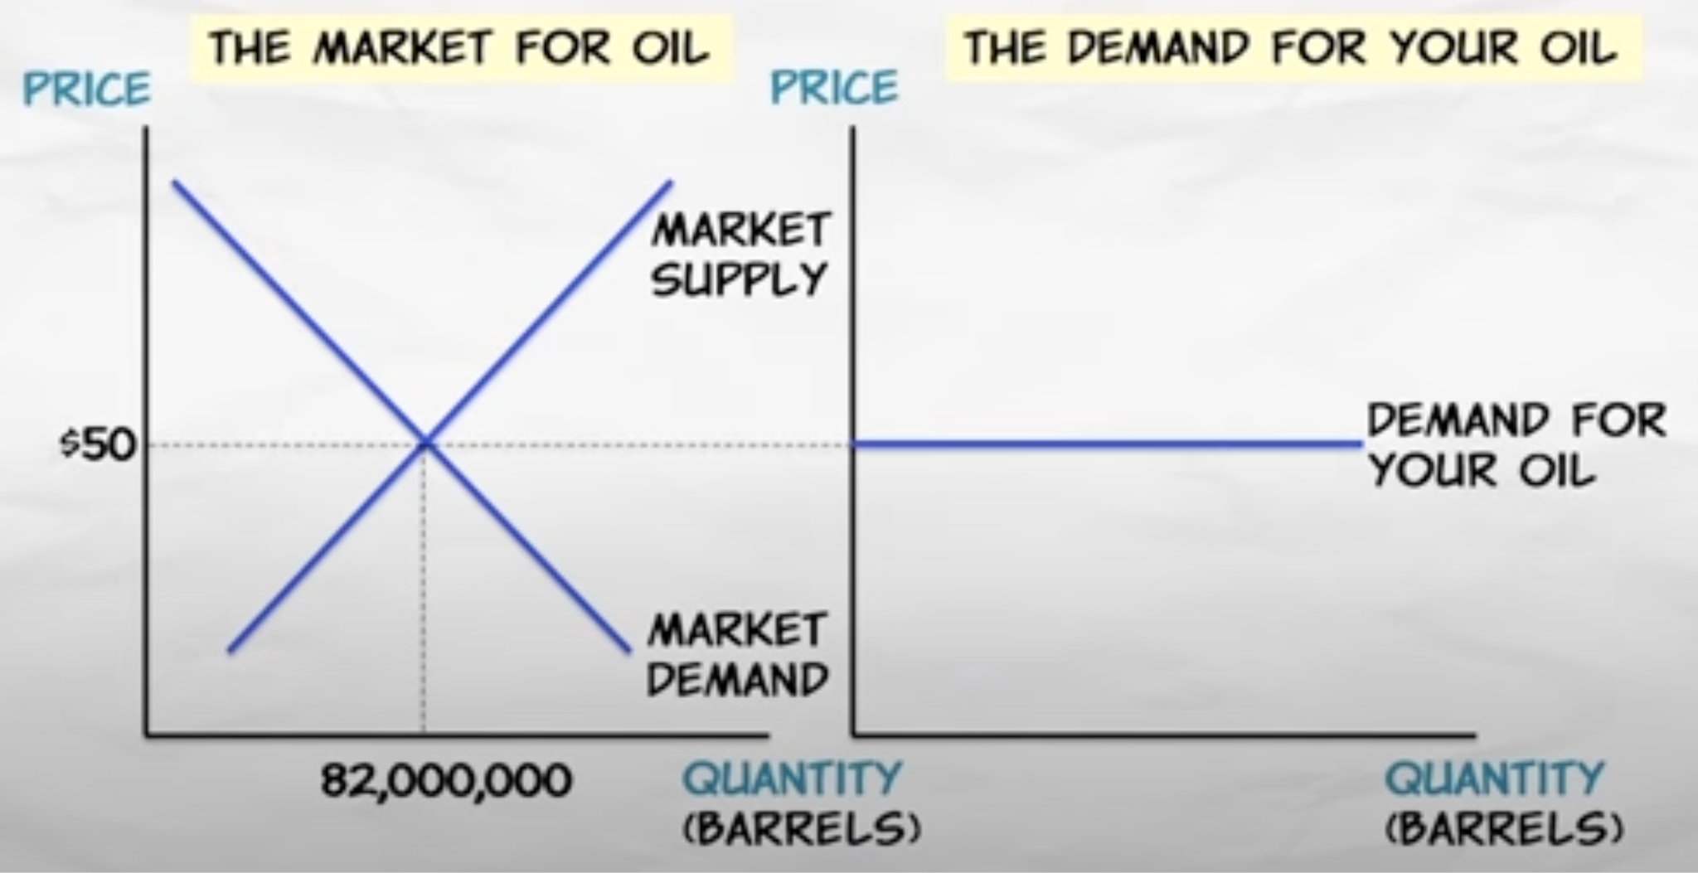
Perfect Competition
Price takers

Slide 14
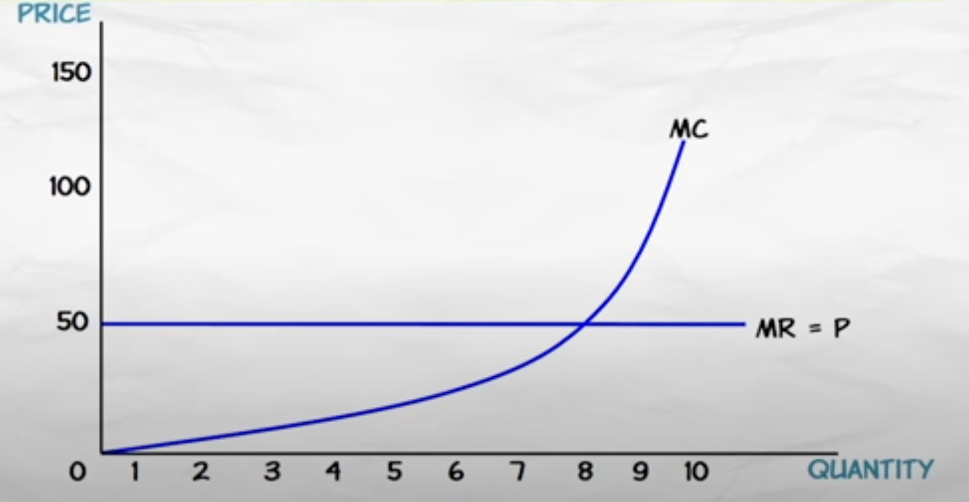
Perfect Competition

Slide 15
Perfect Competition
PERFECT COMPETITION
Long-Run:
new firms are free to enter the industry
existing firms are free to exit the industry

Slide 16
Consequences of Easy Entry/Exit
Short-Run
Long-Run
positive economic profit
new firms enter the industry, price falls as does profit
negative economic profit
existing firms exit the industry, price rises as does profit
So the long run equilibrium is zero “economic” profit or normal accounting profit

Slide 17
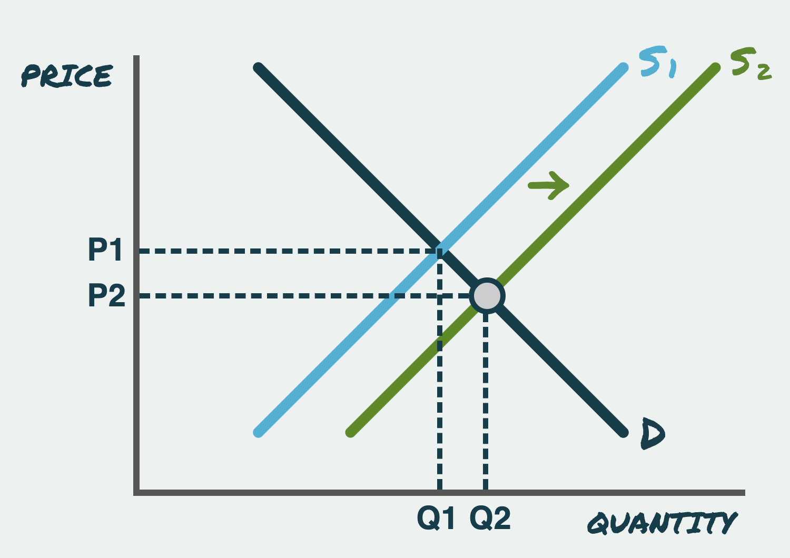
Profit
High Profit -> New Firms Enter -> Supply Shifts -> Price Decreases -> Profit Decreases

Slide 18
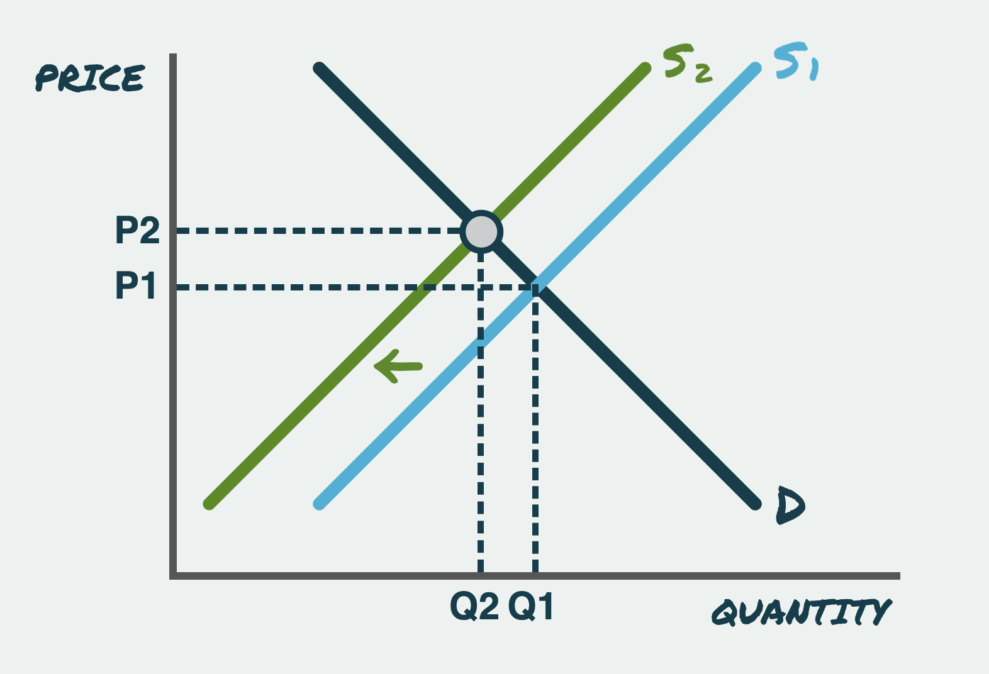
Profit
Negative Profit -> Firms Exit -> Supply Shifts -> Price Increases -> Profit Increases

Slide 19
Perfect Competition
 | Perfect Competition
Profits | “Normal”
Price | P=MC

Slide 20
PERFECT COMPETITION
Firms want to avoid perfect competition - business term is “commoditized”
Assumptions
  All goods the same
  Many buyers and sellers so no one individual buyer or seller can affect price --- “price takers”
    Easy entry and exit
  Everyone knows price and good quality, no asymmetric information

Slide 21
Total Cost is TC=100+10Q+Q²
P is $50
What is the optimal quantity?
What is the total profit?
Is the market in a long run equilibrium? Why or why not?

Slide 22
Total Cost is TC=100+10Q+Q²
P is $50
What is the optimal quantity?
What is the total profit?
Is the market in a long run equilibrium? Why or why not?
What will the long run equilibrium price be?

